Slide 1

Financial Modeling: Earnings Call Natural Language Processing Analysis
Bat Baasan

Slide 2
Goal
To use Natural Language Processing to analyze earning call transcripts and consequent ticker quarter growth to predict performance as compared to respective index.
Source: Daniell Kenneth (GitHub)

Slide 3
What is Earnings call Transcript?
is a conference call between the management of a public company, analysts, investors, and the media to discuss the company’s financial results during a given reporting period, such as a quarter or a fiscal year
Usefulness:
Glean the most current information and data about a company’s revenue, strategic direction, etc., directly from company leadership
See how the company is proactive/ reactive positioning themselves “optics”/ “spin”
Discover what issues analyst are probing via their questions to determine what those in industry think are key to understanding the performance of the company
Source: FPM and NYU guides

Slide 4
Similar analysis
Stock prediction: Using Earnings Call Transcript to Predict Stock Performance (Stanford)
Decision-Making; Modeling Financial Analysts decision making via the pragmatic and semantics of earnings call (Cornell)
Stock market volatility: Volatility Prediction using Earnings Call Transcripts and Rationale behind the Model Prediction (Georgia Tech)
Notes:
Some

Slide 5
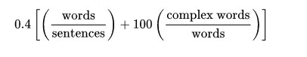
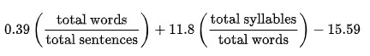
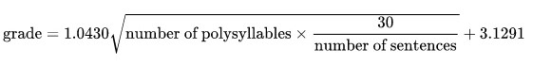
Language Metrics and its math Expression:
Gunning Fog Index:
Felsch- Kincaid Grade Level:
SMOG:

Slide 6
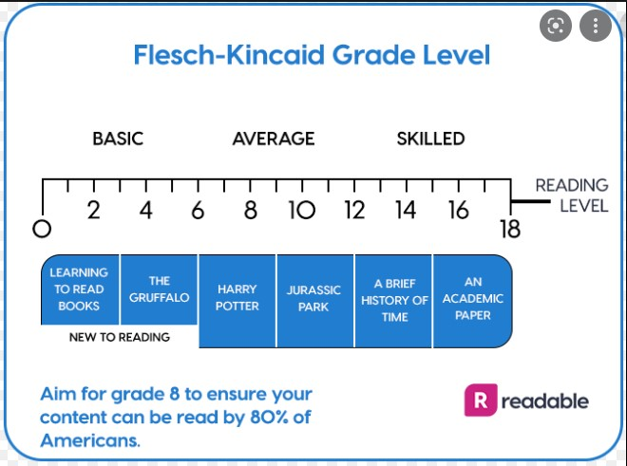
Source: Readable

Slide 7
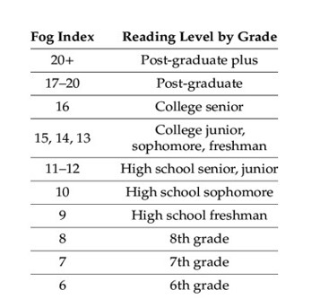
Source: Gunning Fog

Slide 8
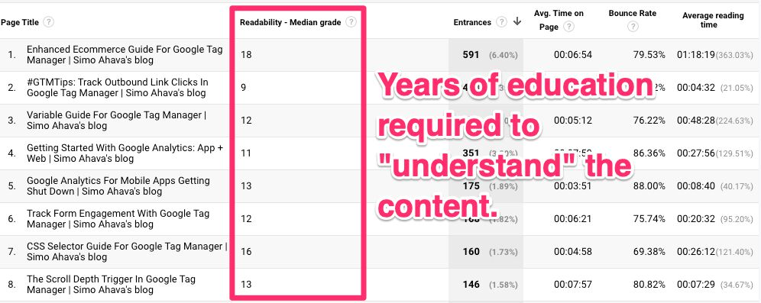
Source: Simo Ahava

